Slide 1
Vision for the Future
Presentation at the
MD-DC Utilities Association
Betty Ann Kane, Chairman
Public Service Commission
of the District of Columbia
September 12, 2013

Slide 2

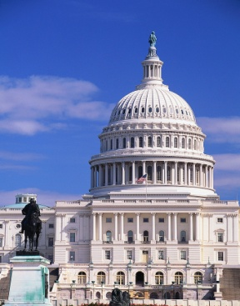
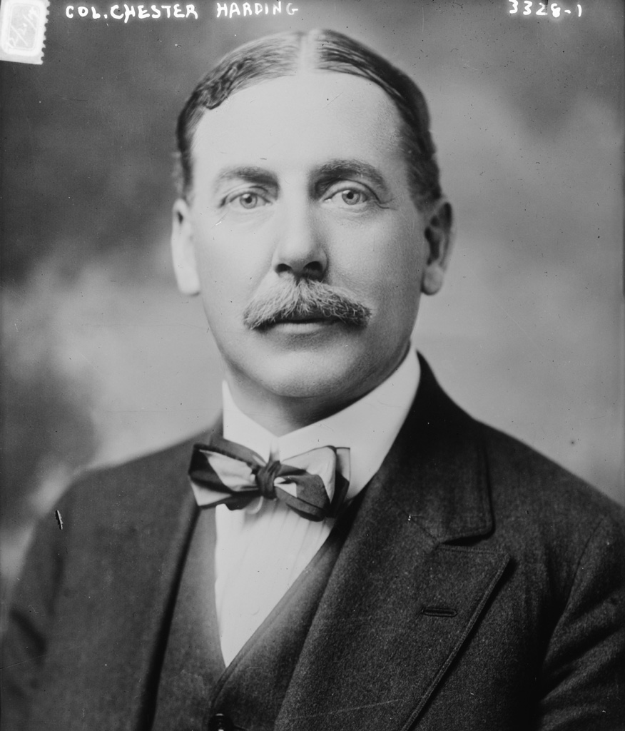
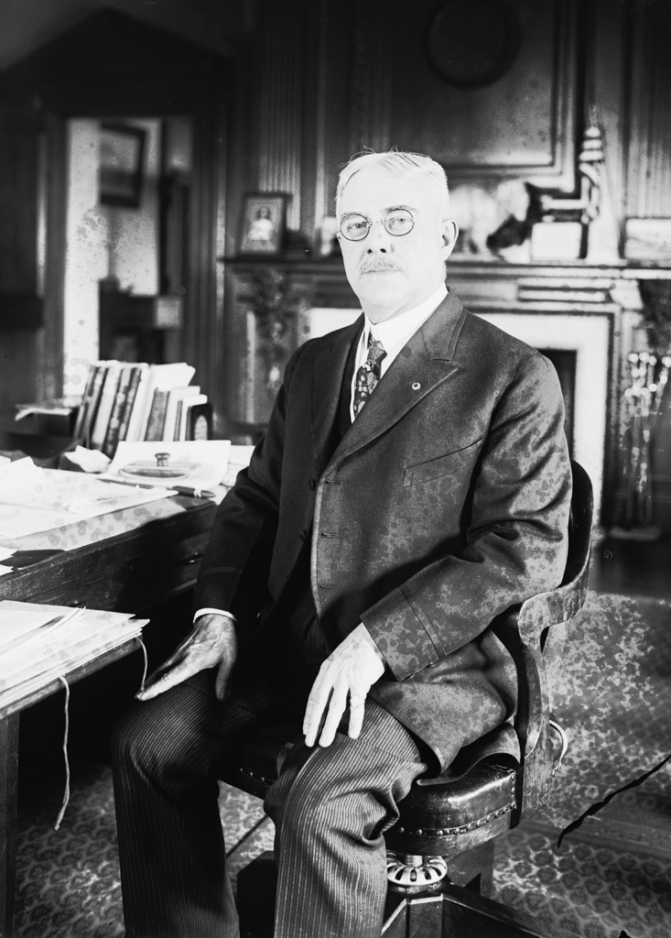
District of Columbia
Public Service Commission
Celebrating our Centennial 1913- 2013
The first two PSC Commissioners
Chester Harding (Chairman) Cuno Rudolph

Slide 3
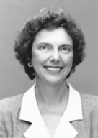
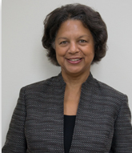
Commissioners for the
DC Public Service Commission
Vacant Seat
Betty Ann Kane
Joanne Doddy Fort

Slide 4
Market Share Electricity Usage

Slide 5
Electricity Customers

Slide 6
Market Share Natural Gas Usage

Slide 7
Natural Gas Customers

Slide 8
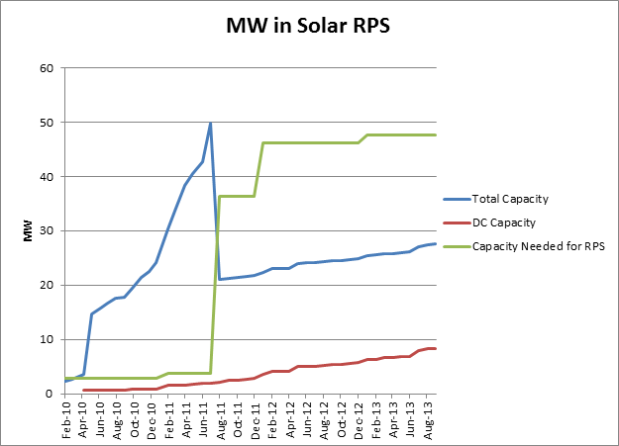
MW in Solar RPS

Slide 9
Capacity Needed for Solar RPS

Slide 10
Incremental MW Needed Each Year for Solar RPS

Slide 11
District Derecho Storm Map

Slide 12
The End

