Slide 1
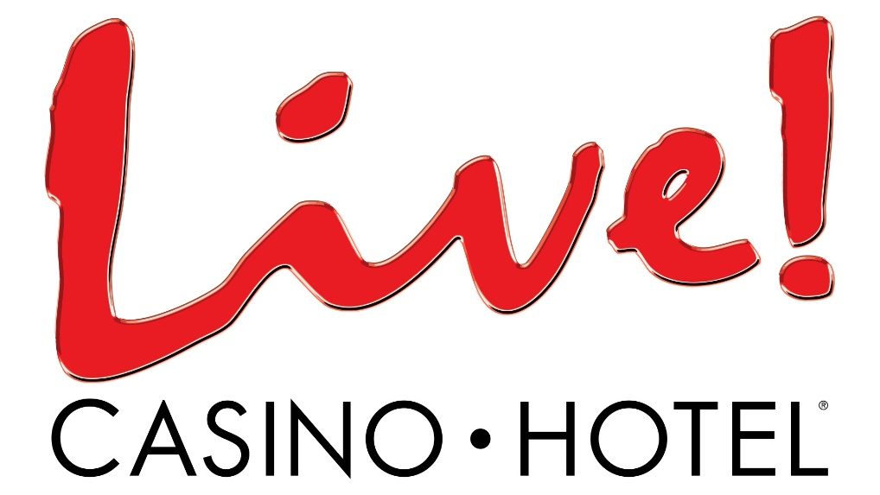
Everybody is Watching Everybody
A Layered Approach to
Security
Notes:
Just as the clip from the movie “Casino” says “everybody is watching everybody”
Good morning/afternoon –
My name is Dwight Johnson and I am the Director of Security at Live! Casino & Hotel
I am honored to speak with you today about Live!, especially as it relates to this year’s theme “Protect and Serve – Mandates for the Modern Utility”.
Our focus, just as the conference focus, is on the challenges associated with protecting people, systems, infrastructure and resources as well as providing an exceptional customer experience is something we do 24/7.
Casinos have evolved from how they are depicted in that movie which came out in 1995. In fact, things are very different since the tragedy of 9/11. So we need to ask ourselves are we any safer?
The terror attacks spurred agency cooperation and high-tech safety measures everywhere. Forcing casinos and other potential targets to improve preparedness for future terrorist attacks.
As we have seen in the news, terrorists are sometimes lone wolves and seem to like high-profile communities and the United States leads the world in commercial gaming establishments.
Maryland is just one of those state’s which generate billions of revenue per year in legalized gambling.

Slide 2
Maryland Casinos
Notes:
In 2008 voters approved the installation of slot machines (VLTs) in Maryland.
The 1st gaming facility was Hollywood Casino Perryville (Cecil County) on September 27, 2010, The 2nd gaming facility was Casino at Ocean Downs (Worchester County) on January 4, 2011, Live was the 3rd to open on June 6, 2012. 3 others opened since then – Rocky Gap, Horseshoe and MGM National Harbor.
Maryland Casinos have generated billions of dollars in gambling revenue since 2010. During Live’s first fiscal year we grossed more than $654 million, helping to put gambling on track to become a $1 billion industry.

Slide 3
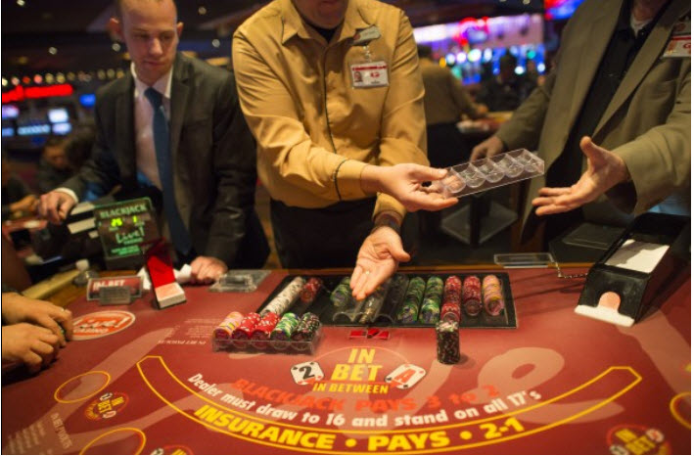
Live! Casino & Hotel
Opened on June 6, 2012
Located between Baltimore and Washington, DC just off I-95, Route 100 and B/W Parkway at Arundel Mills, Hanover, Maryland. The Casino is just step to Arundel Mills Mall, which attracts more than 14 million visitors a year.
Opened 24 hours a day, 7 days a week, 365 days a year.
The over 330,000 square foot, $500 + million revenue generating Live! Casino is one of the largest commercial casinos in the country delivering premiere gaming and entertainment experiences in the Mid-Atlantic region.
The Casino features over 4,200 Video Lottery Terminals (slot machines) and over 200 live action table games, including a 2 story Poker Room.
Notes:
LIVE OPENED JUNE OF 2012,

Slide 4
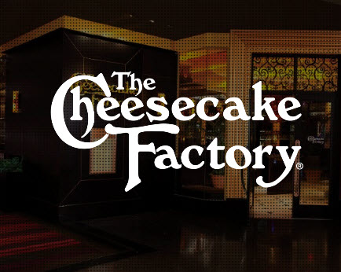
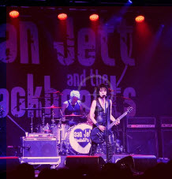
Live! Casino & Hotel
The property features a 7-story -5000 space parking garage with valet
Dining options such as Bobby’s Burger Palace from Chef Bobby Flay, The Cheesecake Factory, The Prime Rib, Phillips Seafood Express, Morty’s Deli, Luk Fu serving Asian cuisine and others.
Entertainment at Live! Center Stage. Center Stage can host sit-down dinners, classroom seating and theater style seating for concerts or shows for 500 and several bars.
If that isn’t enough, in September of 2016, Live! Casino broke ground on a $200 million, 360,000 square foot, 17-story, 310-room hotel, that includes meeting space, a concert venue, spa, new dining options and a day spa/salon. Making this the tallest building in Anne Arundel County.
Go Live! Is set for the first quarter of 2018
Notes:
7-story -5000 space parking garage
Dining options such as Bobby’s Burger Palace from Chef Bobby Flay, The Cheesecake Factory, The Prime Rib, Phillips Seafood Express, Morty’s Deli, Luk Fu serving Asian cuisine and others
Entertainment at Live! Center Stage
If that isn’t enough, in September of 2016, Live! Casino broke ground on a $200 million, 360,000 square foot, 17-story, 310-room hotel

Slide 5
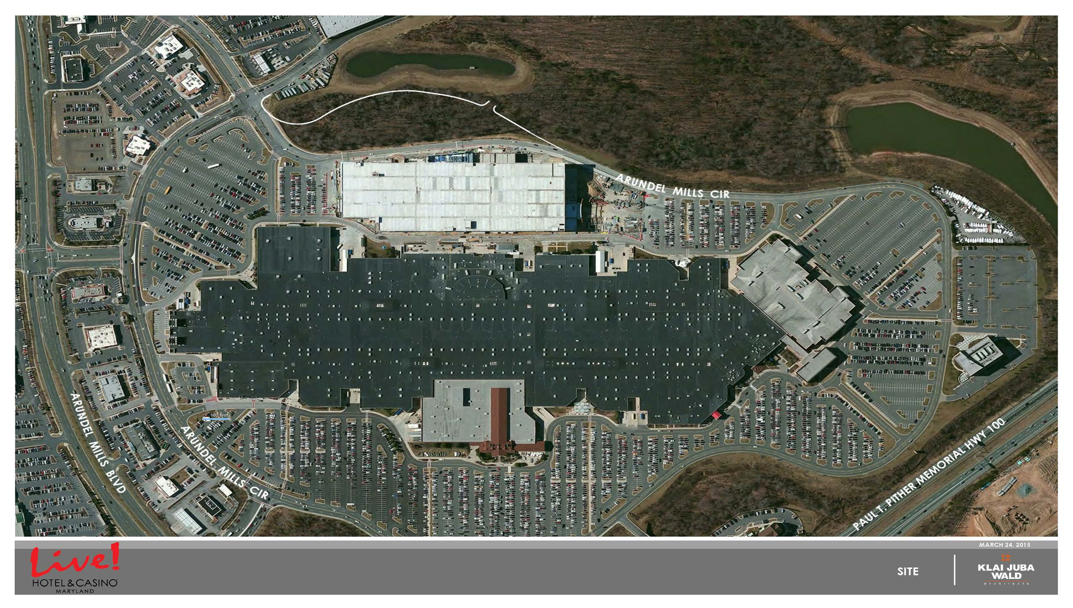
Notes:
This gives you an idea of our size. This is the casino and the mall together

Slide 6
Notes:
This is a an aerial view of the hotel under construction

Slide 7
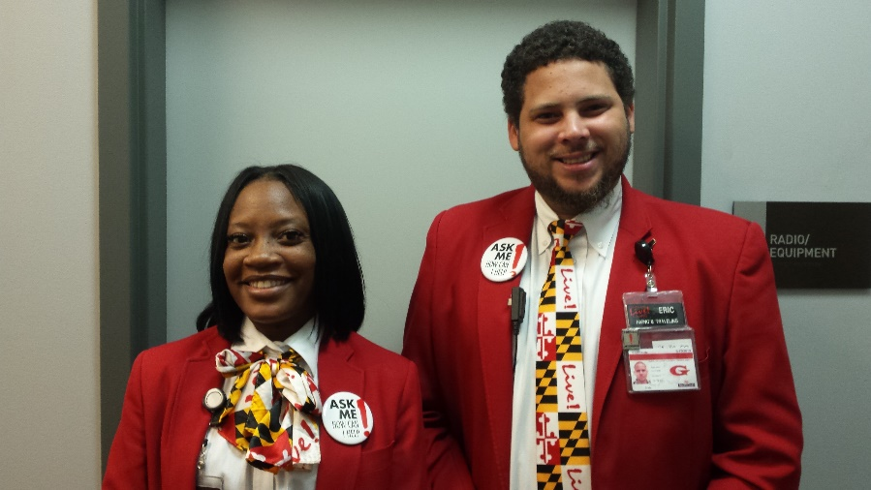
Live! Casino & Hotel
Every month thousands of gamblers stream into Live! Casino, leaving between $40-$50 million in revenue. (an average day 15,000-20,000 guests pass through our doors
The Maryland State Lottery and Gaming Control Agency regulate casinos in accordance with the gaming laws of Maryland.
By law, no one under the age of 21 years of age is permitted to enter.
Live! Employees almost 3,000 employees.
Notes:
3,000 employees

Slide 8
Live! Casino & Hotel
The property is huge
There are SUBSTANTIAL AMOUNTS OF CASH
There is more than $16 billion in visitor spending each yr.
At any given time the casino is often extremely crowded.
Large numbers of people means thousands of parked vehicles; traffic flow is a concern
This is a vibrant tourism industry
We are steps away from a 1.6 million square foot Mall
Notes:
The reason I shared with you some of our history and facts is to attempt to help paint a picture in your mind what we are dealing with. This property is huge, there are thousands of people, visitors, vehicles and lots and lots of money.

Slide 9
Live! Casino Security
We face many challenges
Using a layered security or defense, multiple components and strategies are used to protect operations on multiple levels
A Security team and a state-of-the-art surveillance department protects these millions from thieves, cheats, drunks and other threats
The more than 2,000 cameras in and around the over 330,000 square-foot casino and 7 story, 5000 space garage are monitored from the surveillance department
Notes:
Regardless of the business model, it is imperative to create a well balanced security program. At the forefront of these efforts stand casino security and the surveillance department. Together we secure our assets by implementing a multi-layered approach to security by incorporating people, processes and technology. Should one layer fail the other layers can compensate and continue to secure our assets.
Just like a trapeze artist performing a high wire act understands the importance of balance, so must the casino’s security and surveillance departments.
The role of casino security is very different from the duties and challenges of a traditional Security Department, with the major differences being that the casino has a broader scope of security issues than other settings. Security with the help of our Surveillance Department is responsible for providing reliable protection against crime, to prevent theft or damage to our assets, the escorting of casino funds and guests, to respond to emergency situations, to identify cheats or scams and to greet customers.
As with many private enterprises, casino security exists also to protect properties from themselves. Sometimes employees attempt to cheat at games, execute some form of fraud or internal theft and even in collusion with someone not employed by the casino.

Slide 10
Layers of Protection
Ask the question, “What is the threat?”
The Security Program starts with a concentric ring approach
Starting with the perimeter and working your way in
You can always add layers
Identify the risks
Notes:
One of the most effective ways of creating a robust program is to understand what you are protecting against. The question to ask is, “What is the threat?” Designing an effective and sustainable security program starts with a concentric ring approach to add layers of protection. Start with the perimeter and work your way to the interior part of the building. Add layers of protection until you reach your final objective.
Protecting the exterior of a building involves decisions related to distance and infrastructure. Traffic lanes, sidewalks, dining venues, public transportation, parking conditions, and public utilities such as drains/sewers, electrical and mechanical systems.
It is important to identify potential risks to the property based on specific perimeter elements. For example, a vehicle traveling at a high rate of speed crashing into pedestrians or the main entrance of the building is a risk. One solution is to create greater distance between traffic lanes and the building. Installing high-impact vehicle barriers around the perimeter of the building or loading dock is an effective layer of protection to detour or minimize this potential threat.

