Slide 1
Change is Here: Are You a Transformer?
Maryland / District of Columbia Utilities Association
Hyatt Regency Chesapeake Bay
September 22, 2016
The Honorable Wendell F. Holland
Former Chairman of the Pennsylvania Public Utility Commission

Slide 2
Themes
National Scene
Key Issues in the DC/Maryland Region
Local Economic Development Challenges and Opportunities

Slide 3
National Scene
Definition
Impact of November elections on regional utilities
  Presidential
  Congress
  FERC/EPA

Slide 4
Key Issues in the DC/Maryland Region
.
Merger integration
Rate cases
Cyber security
Water Industry issues
Reliability
Education and Training

Slide 5
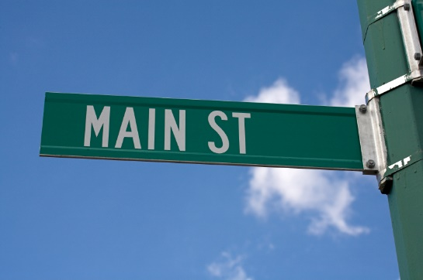
From Wall Street to Main Street
Benefits of Local Financing
The Borrowing Company/Utility
Strengthens its access to capital sources not dependent on LIBOR wholesale market
Achieves diversification in its lending group, thereby adding sources of liquidity
Demonstrates its commitment to the local banking industry
Contributes to local economic development
Helps strengthen its regulatory and governmental relationships and ties to its other important local and State stakeholders
Participating Banks
Gain an attractive addition to their existing client rosters thus strengthening their Federal Reserve and other bank regulatory portfolio ratings
Have ability to fund other local businesses due to improved regulatory ratings
Receive recognition both locally and beyond for being part of a company’s financing team
Support local and regional community development and jobs creation

Slide 6






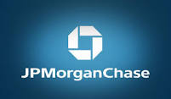

Commercial banking is transforming
Global banks provide major commercial credit facilities to our utilities
Dodd-Frank and Basel regulations are pressing their balance sheets and income statements
Brexit will have an impact also
Local and regional banks in our area can be very competitive and are eager to make investment grade loans
Local and regional banks have 64% of the $176 billion deposits in Maryland and DC

Slide 7
Local Economic Development Challenges and Opportunities
Win-win for utilities and their local banking resource
Diversity potential

Slide 8
Some representative local banks
Maryland
District of Columbia
Sandy Spring Bancorp, Inc. (MD)
Eagle Bancorp, Inc. (MD)
Fulton Financial Corporation (PA)
Old Line Bancshares, Inc. (MD)
Revere Bank (MD)
F.N.B. Corporation (PA)
Community Financial Corporation (MD)
Shore Bancshares, Inc. (MD)
Howard Bancorp, Inc. (MD)
First Mariner Bank (MD)
Eagle Bancorp, Inc. (MD)
United Bankshares, Inc. (WV)
National Capital Bank of Washington (DC)
WashingtonFirst Bankshares, Inc. (VA)
IBW Financial Corporation (DC)
Workers United (NY)
City First Enterprises, Inc. (DC)
Premier Financial Bancorp, Inc. (WV)
Cardinal Financial Corporation (VA)
Congressional Bancshares, Inc. (MD)

Slide 9
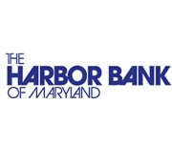
Diversity Potential
Achieving various diversity objectives difficult to impossible via global banks
Finding ways to include local and regional banks should provide win-win roles for qualifying diversified entities

Slide 10
Conclusion
“Change is the law of life. And those who look only to the past or present are certain to miss the future.“
                John F. Kennedy

